Slide 1
Exploratory Data Analysis (EDA) Report
Deepseek Reaction Dataset - Insights & Findings
Presented by: Prudhvi.P

Slide 2
Project Overview
Objective: Analyze tweet engagement metrics to identify trends, outliers, and potential bots.
Key Questions:
What are the most engaging tweets?
Are there any anomalies or bots in the dataset?
How do engagement metrics vary across regions and time?
Tools Used: Python, Pandas, Seaborn, Matplotlib.

Slide 3
Data Overview
Dataset: Tweets with engagement metrics (retweets, likes, replies, etc.).
Key Columns:
createdat: Timestamp of the tweet.
retweetcount, likecount, replycount: Engagement metrics.
author_location: Geographic location of the user.
Data Cleaning:
Handled missing values in author_location using mode imputation.
Converted createdat to datetime format.
Filtered tweets related to specific keywords (deepseek, AI, etc.).

Slide 4
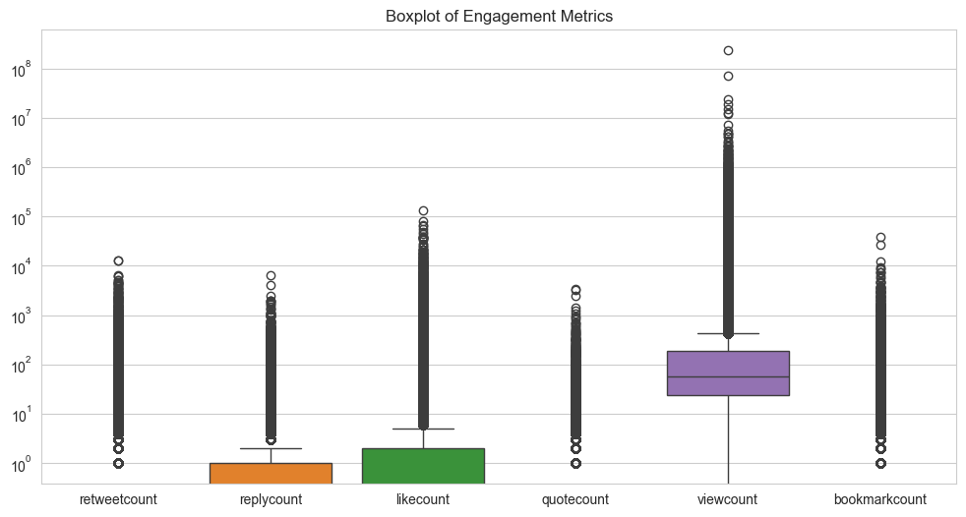
Exploratory Data Analysis (EDA)
Key Insights:
Most tweets have low engagement (e.g., 50th percentile for likes is 0).
Viral tweets (top 1%) have significantly higher engagement.
Visualization:
Boxplot: Distribution of engagement metrics (retweets, likes, etc.).

Slide 5
Outlier Detection
Methods Used:
Z-scores to identify anomalies
99th percentile to detect viral tweets
Findings:
927 anomalies detected
4,632 viral tweets identified (top 1%)
Why Z-Scores?
Captures viral tweets without misclassifying them as outliers
Ensures critical engagement patterns are retained
Outperforms IQR and Winsorisation for this data

Slide 6
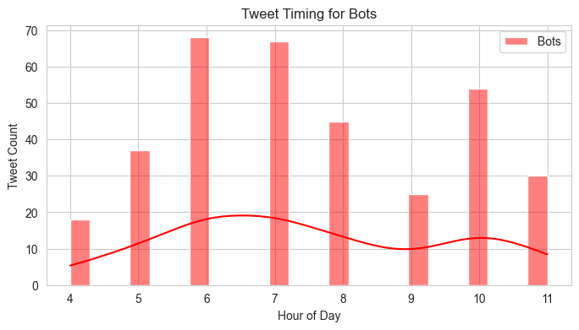
Bot Identification
Criteria:
Low follower count but high engagement.
Frequent posting in short intervals.
Findings:
344 potential bots identified.
30.81% of bot tweets contain links.

Slide 7
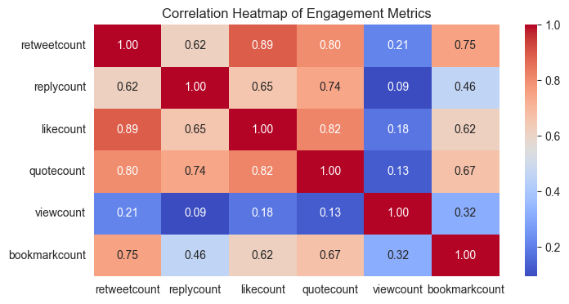
Correlation Analysis
Key Insights:
Retweets, likes, and quotes are strongly linked (0.80–0.89), so focus on shareable content to boost overall engagement.
Views have weak ties to engagement (0.09–0.32), meaning high visibility doesn’t ensure interactions like retweets or likes. Prioritize engagement over views.

Slide 8
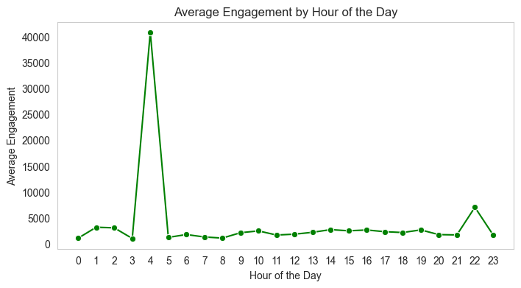
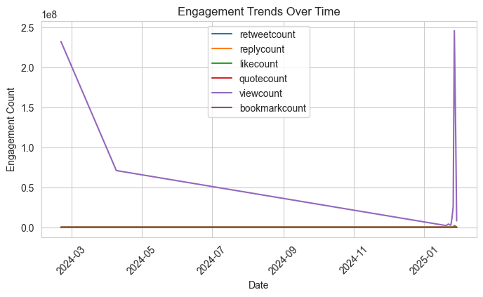
Time-Based Analysis
Key Insights:
Engagement metrics vary over time.
Peaks in engagement during specific hours/days.

Slide 9
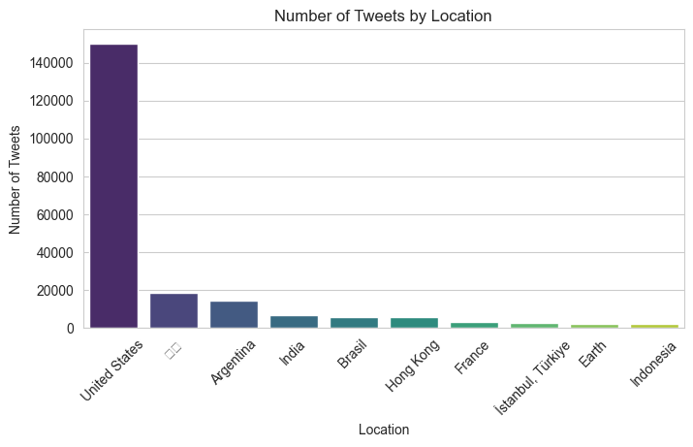
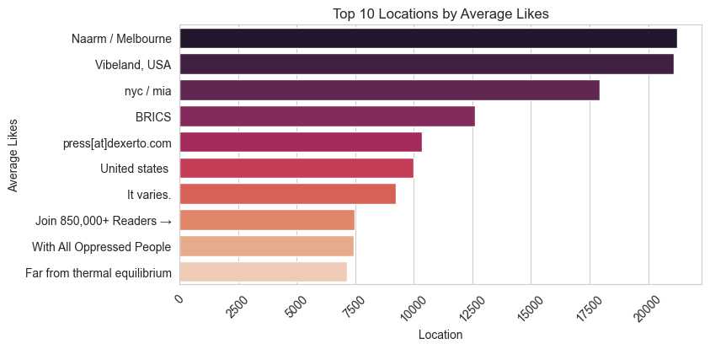
Location-Based Analysis
Key Insights:
Tweets from certain regions like US, UK, India , Australia have higher engagements.

Slide 10
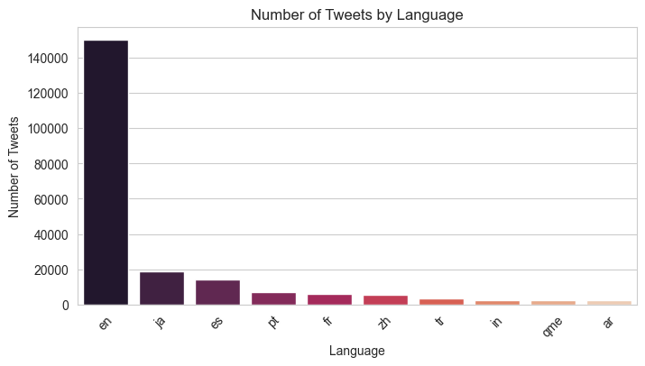
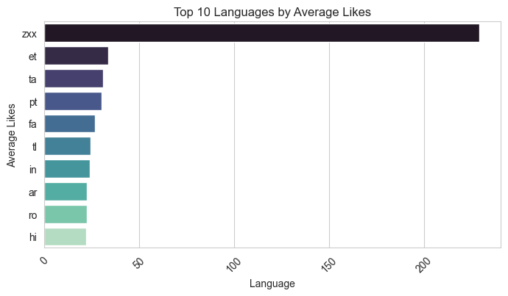
Language-Based Analysis
Key Insights:
The most commonly used languages included English, Spanish, French, Portuguese, Hindi
This highlights key demographics and potential localization opportunities for content strategy.

Slide 11
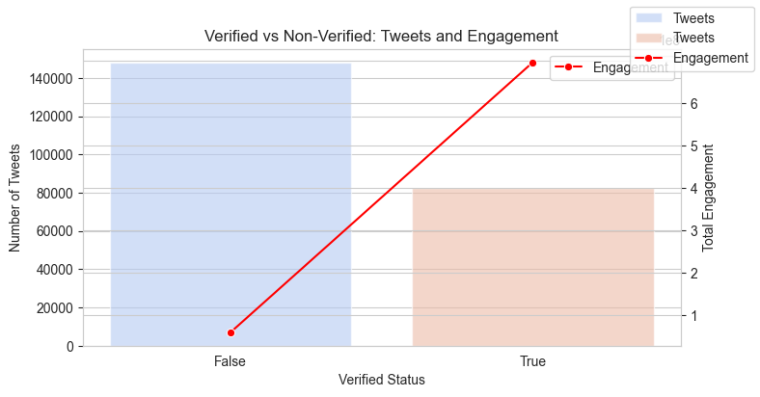
User Segmentation Analysis
Key Insights:
Small group of highly influential users drives the majority of engagement.

Slide 12
Summary and Key Insights
Viral Tweet Patterns: Identified 4,632 viral tweets (top 1%) using Z-scores for accurate detection.
Anomalies Detected: Found 927 anomalies, likely due to unusual engagement behavior.
Geographical Insights: Tweets from the US and UK showed significantly higher engagement rates.
Language Trends: English-dominant content dominated viral patterns, suggesting language-based targeting strategies.
Bot Activity: Bot presence was identified, potentially inflating engagement metrics.

Slide 13
Recommendations
Collaborate with top-performing users to expand reach.
Align content posting times with peak engagement hours.
Leverage regional and language insights for tailored campaigns.
Study viral content patterns to improve content strategy.
Enhance bot detection models to manage automated behavior.

Slide 14
Questions & Answers
Thank you for your attention!
For further discussions, feel free to reach out:
Polamuri.prudhvi97@gmail.com

